Slide 1
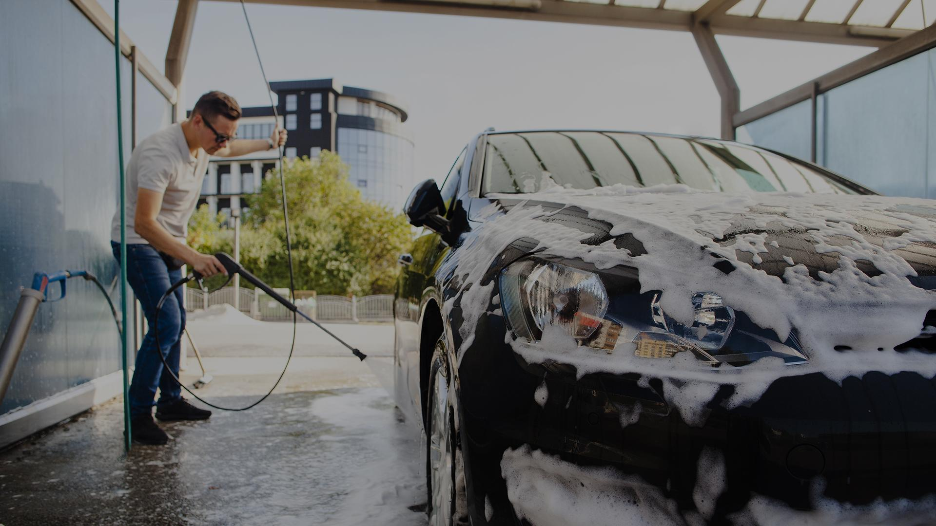
Final PRESENTATION
Supervisor : Ms. S. Thrimahavithana
Co-supervisor: Mr. Roshan Abeyweera

Slide 2
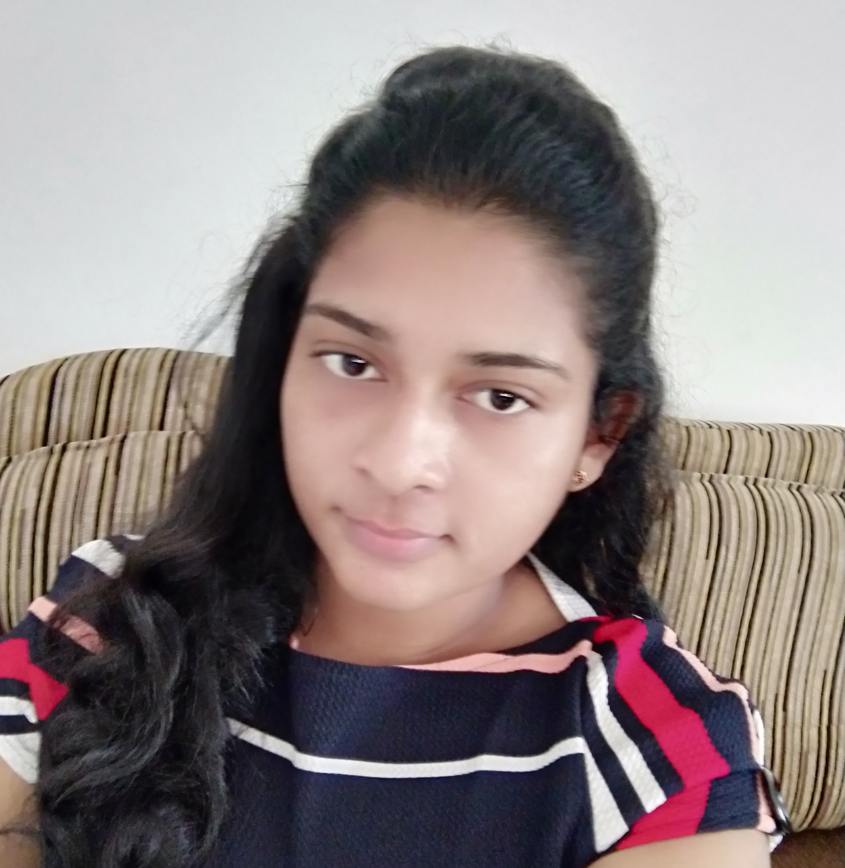

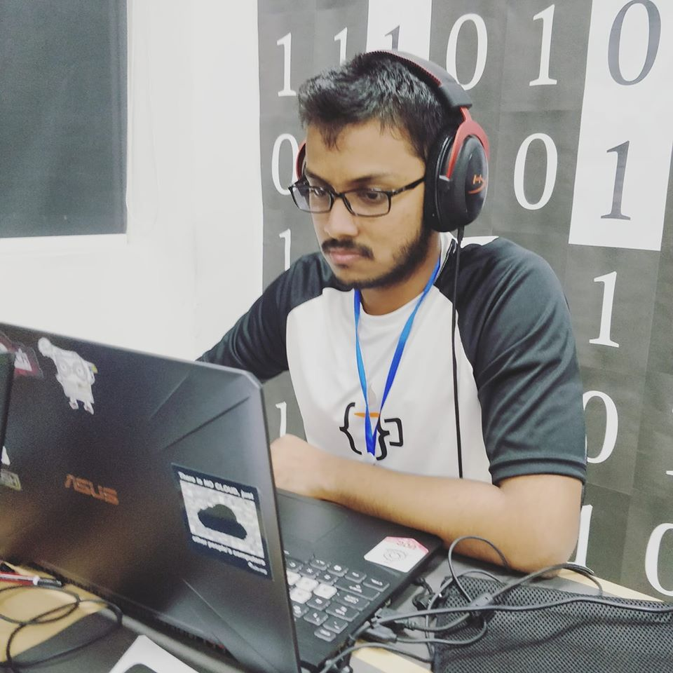

Team CS 37
W.M.D.M.Y. Wickramanayaka
U.W.T.O Weerasinghe
T.W.T. Dulshan
W.K.B.K. Madhushanka
2018/CS/192
2018/CS/048
2018/CS/191
2018/CS/096

Slide 3
TABLE OF CONTENTS
01
02
03
04
05
06
INTRODUCTION
FUNCTIONAL & NON-FUNCTIONAL REQUIREMENTS
DIAGRAMS
SYSTEM ARCHITECTURE
TESTING
TECHNICAL & THEORETICAL KNOWLEDGE GAINED
07
08
09
WORK PLAN
FUTURE ENHANCEMENTS
DEMONSTRATION

Slide 4
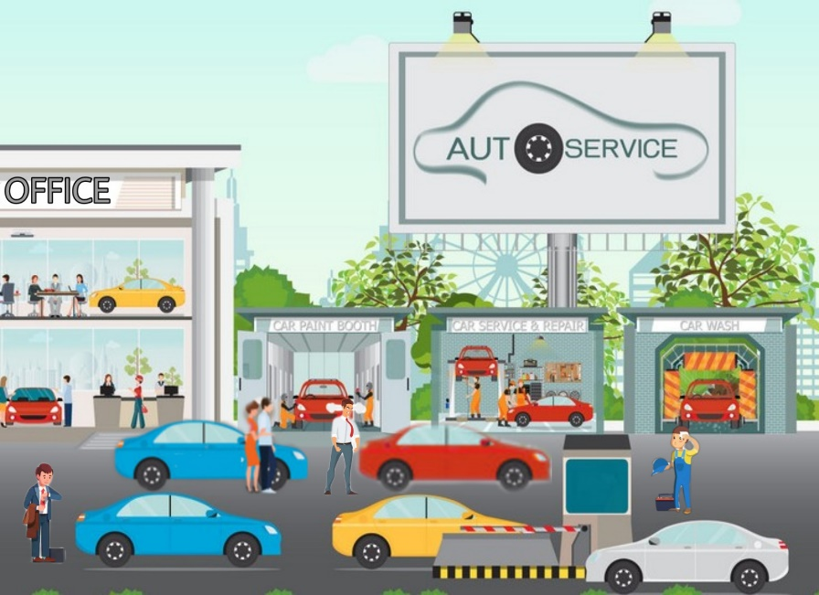
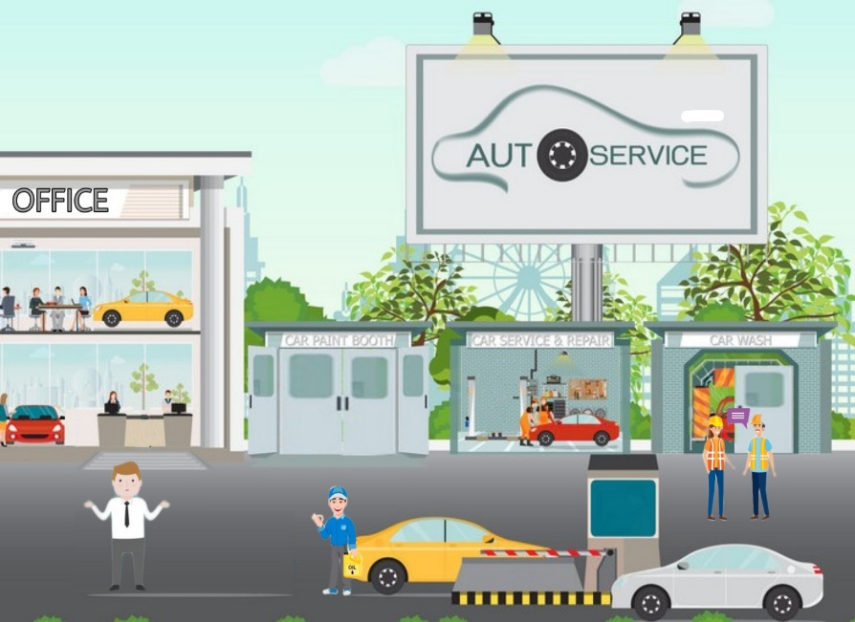
INTRODUCTION TO SYSTEM
Clean Car : An online vehicle reservation system + leave applying system for a vehicle service
Reduce the time wasted by customers at the service station and reduce the constant working hours of employees through an online reservation system. Also let managers take a summary of current business data.

Slide 5
Functionalities for each role:
Vehicle service customers (main targeted)
Employees
Online reservation system
Reservation through smart calendar
(through times displayed publicly
in the calendar)
Cancel / Update reservations
Online advance payment System
Employee leave management system
Apply leave through smart calendar
Can cancel before conditional date
Manager shall accept/reject*
View summary of leaves taken during
a month

Slide 6

Functionalities for each role:
System handler (Receptionist)
Manager (Admin)
Online reservation system
Reservation through smart calendar
for customers manually
Cancel / Update reservations based on
customer calls
Add/Update employee records
Handle Billing.
Accept /Reject employee leaves
Generate reports
Can view summary of following
Employee leaves
Reservations per service type
Number of Cancelled reservations
Has access to all administrative functions

Slide 7


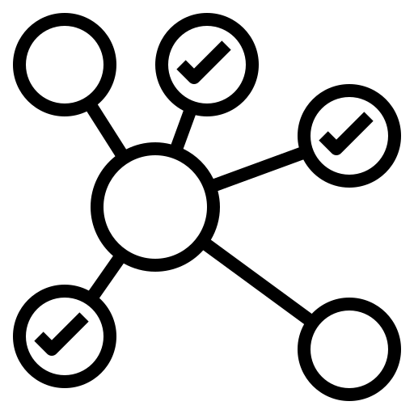

Non-functional Requirements:
Modularity
Security
Testability
Usability (explained in detail later)

Slide 8
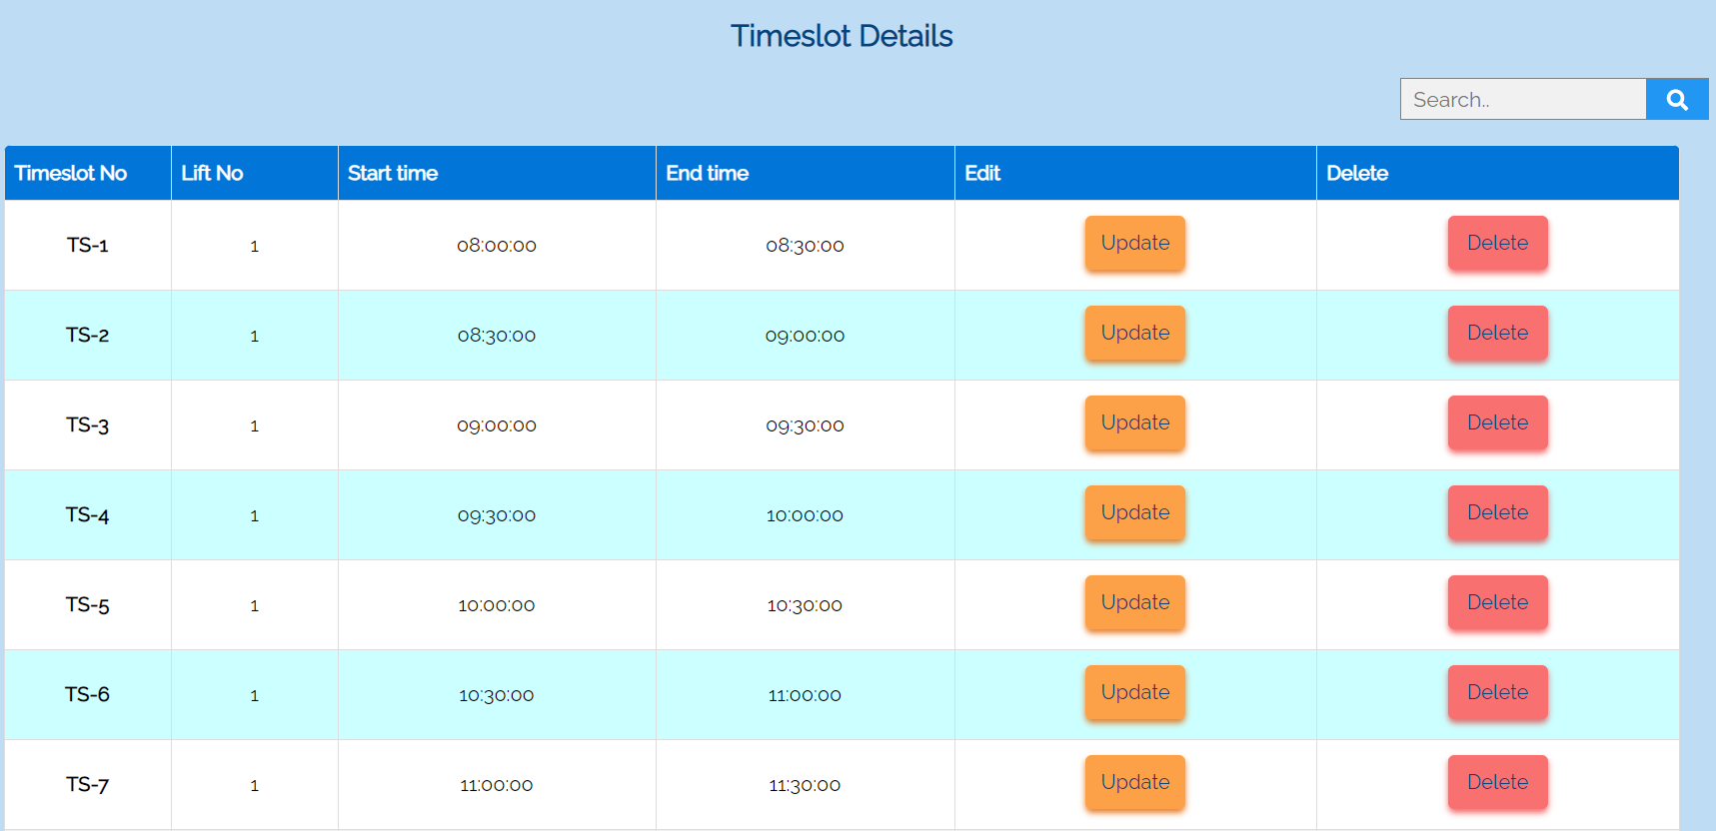
Non-functional Requirements:
Modifiability:
Ability to change/add components(Modularity)
Add/Delete Update: Service type, Timeslot, Reservation

Slide 9
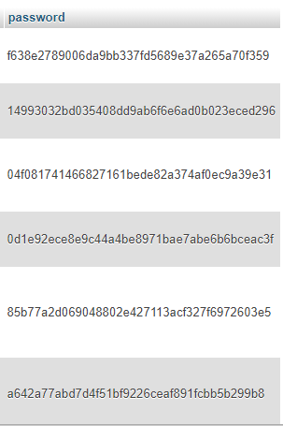
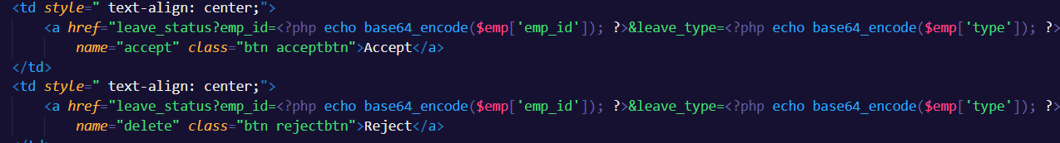
Non-functional Requirements:
Security:
Frontend authentication
Encryption of passwords in database
Base64 encoding in sensitive URLs

Slide 10
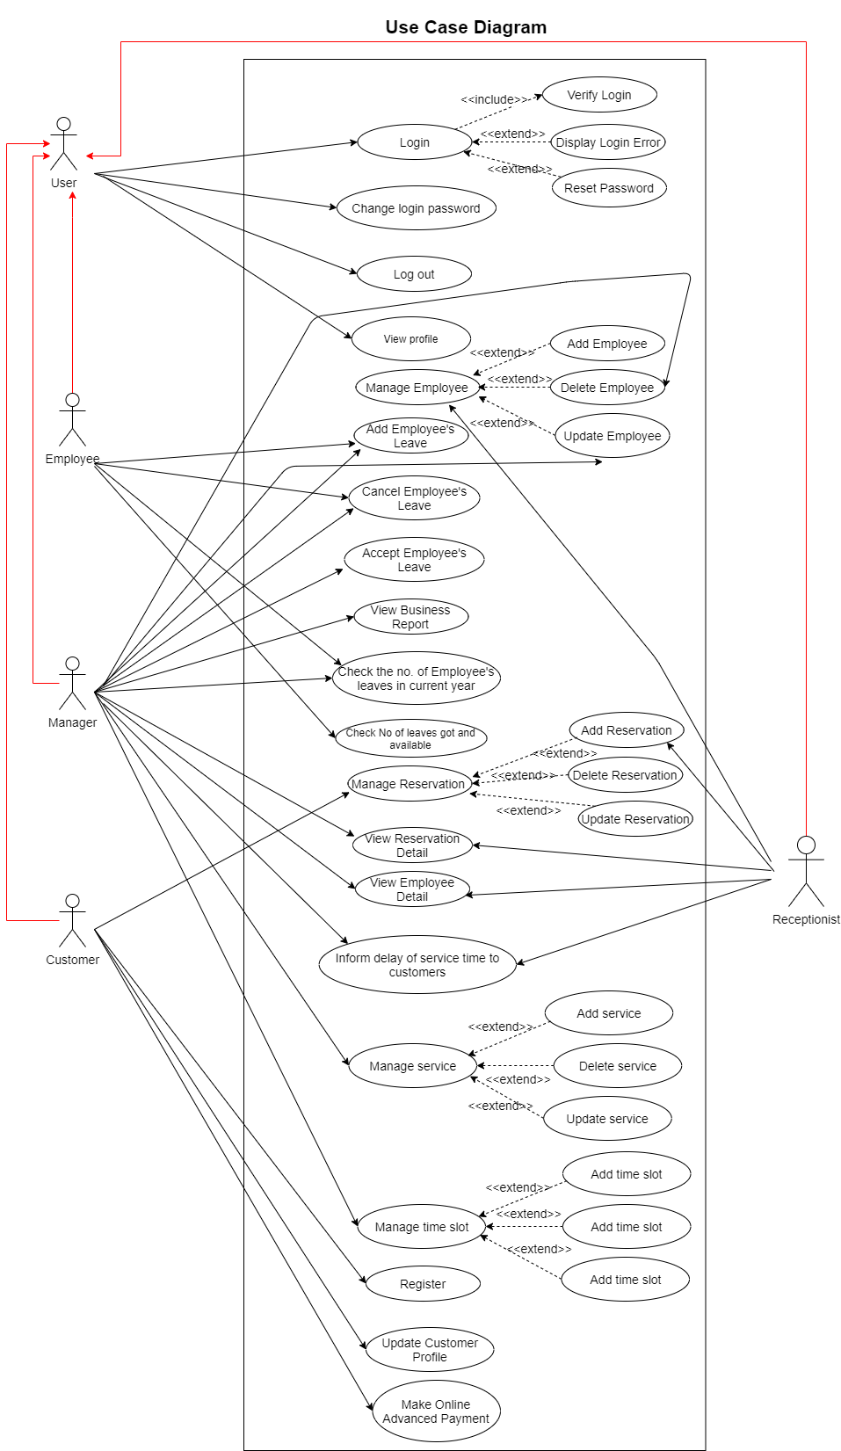
Use case diagram

Slide 11
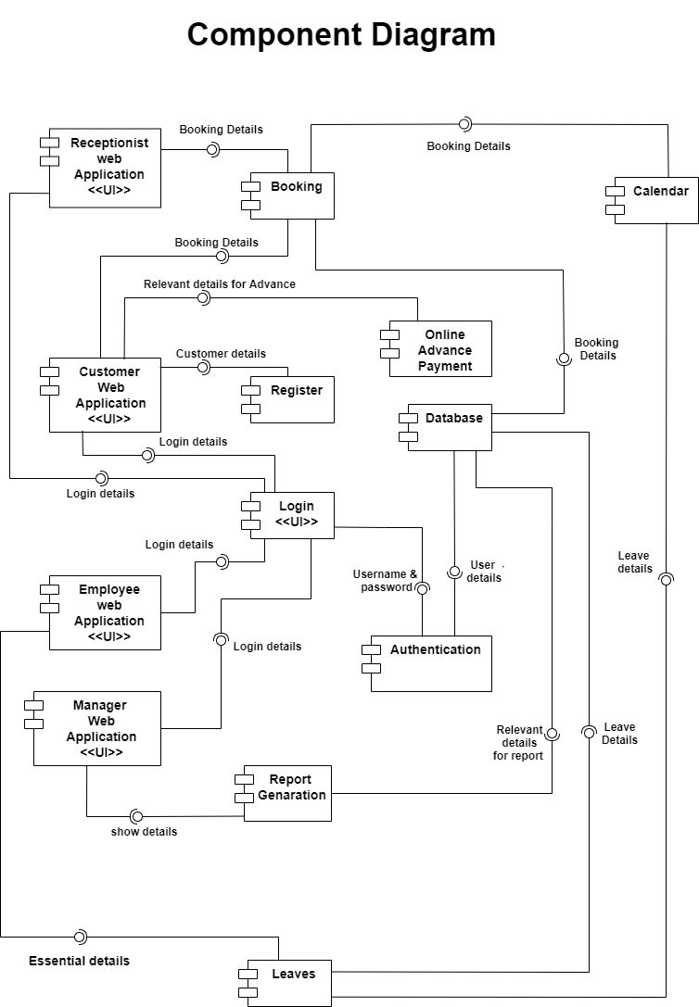
Component diagram (high level architecture)

Slide 12
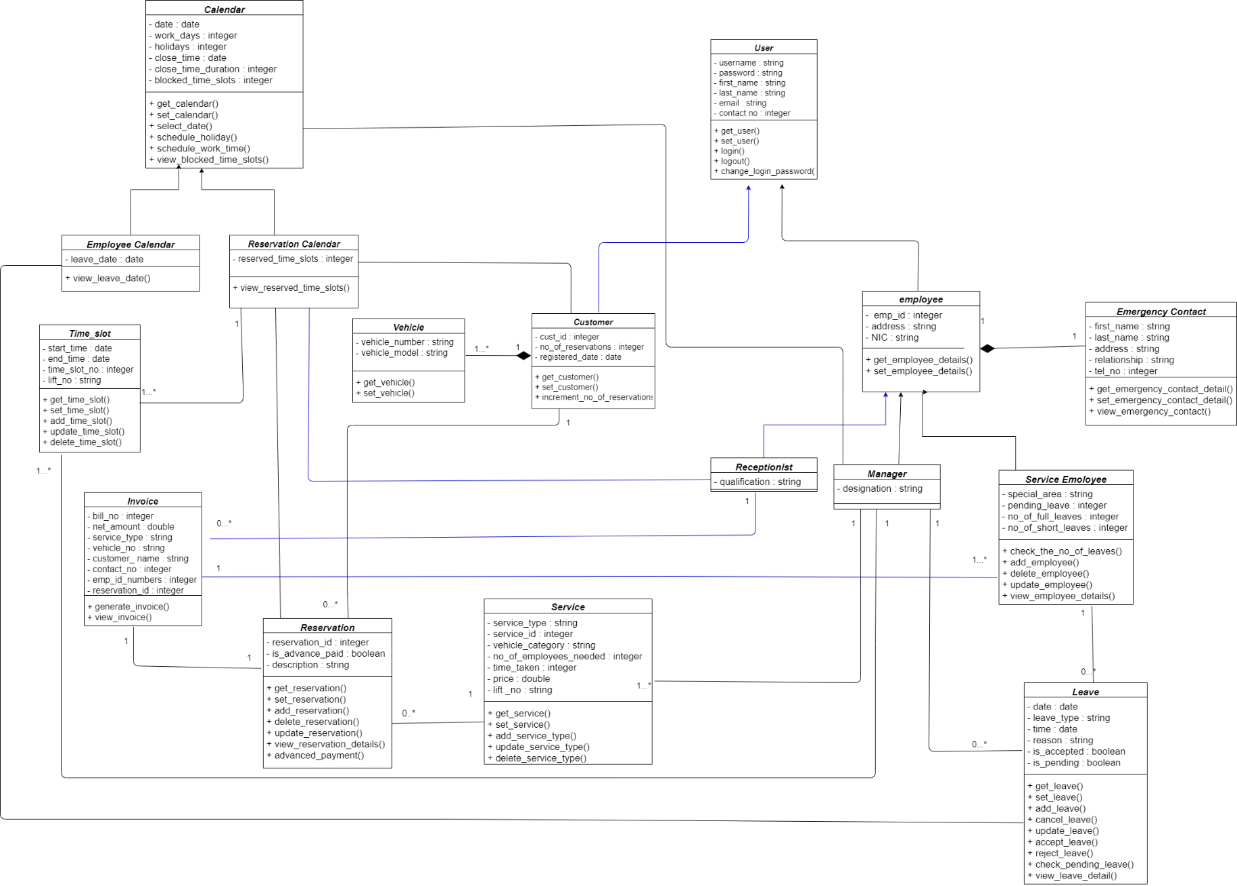
Class Diagram:

Slide 13
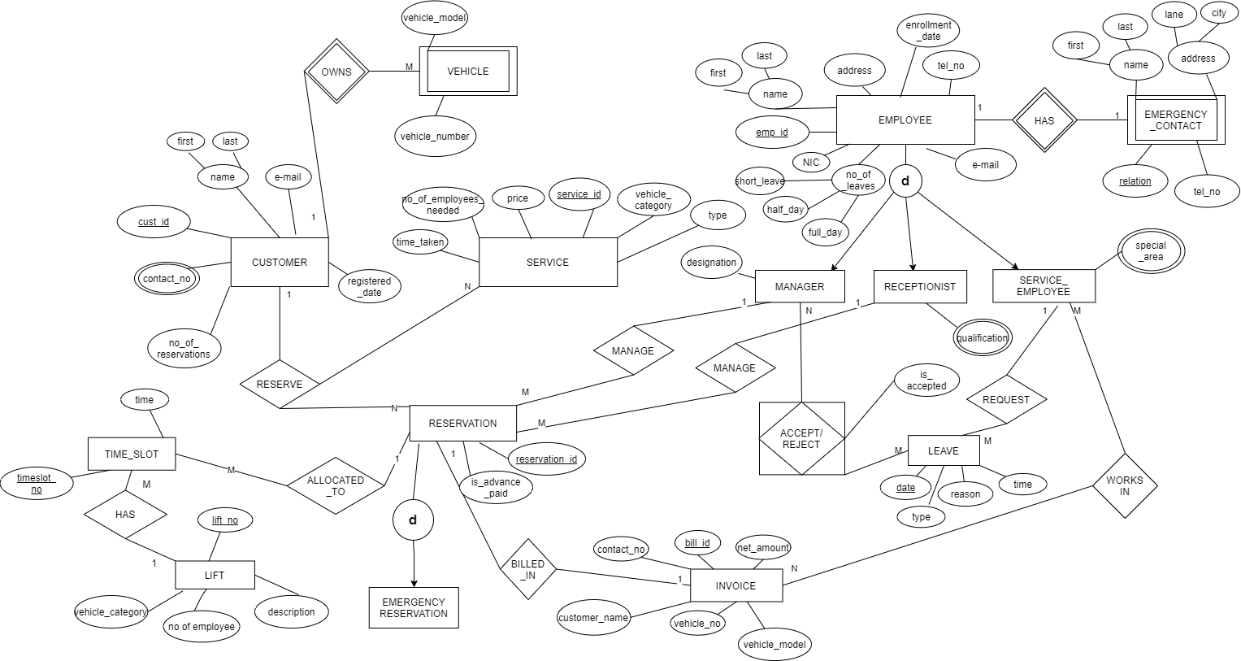
ER Diagram

Slide 14
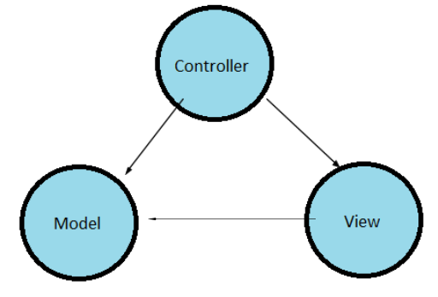
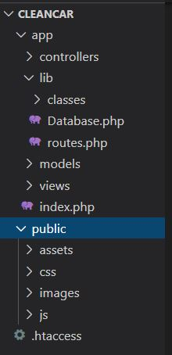
Architecture:
MVC (Model , View , Controller)
Why?
Simultaneous development — Multiple developers can work simultaneously on the model, controller and views.
Ease of modification — Because of the separation of responsibilities, future development or modification is easier i.e. scalability of the product is increased.
Multiple views for a model — Models can have multiple views.

Slide 15
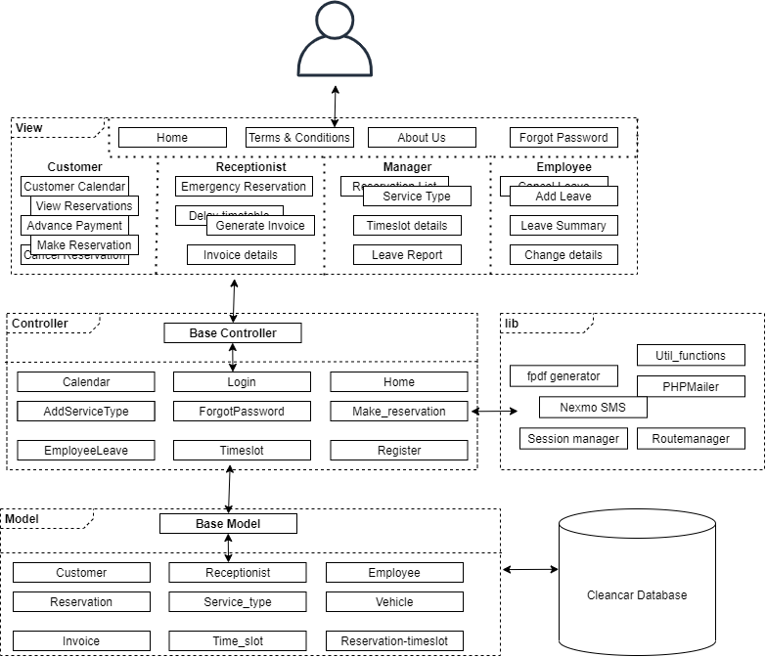
System Architecture Diagram:

Slide 16
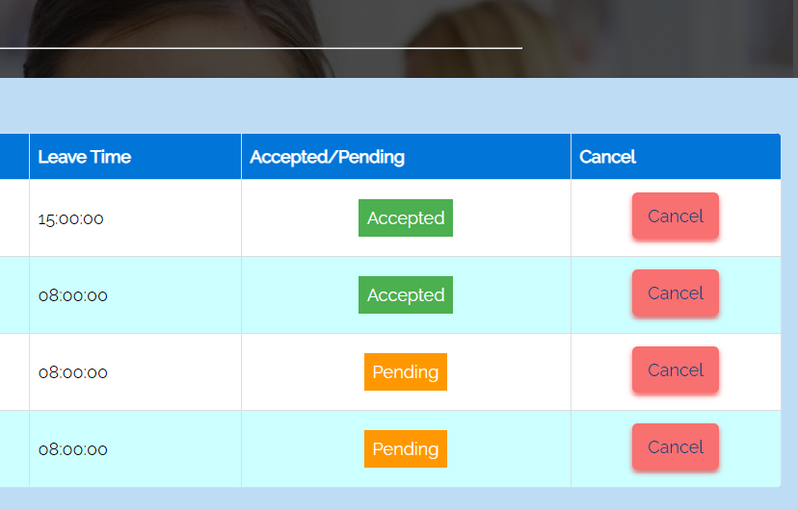
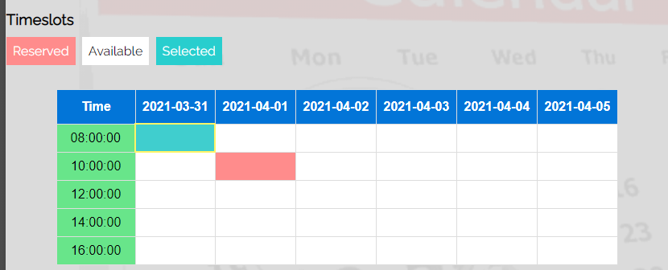
Usability & User experience
Use of appropriate colors and warnings
For labels
For status of selection (Customer Calendar)
Forgot password notification

Slide 17
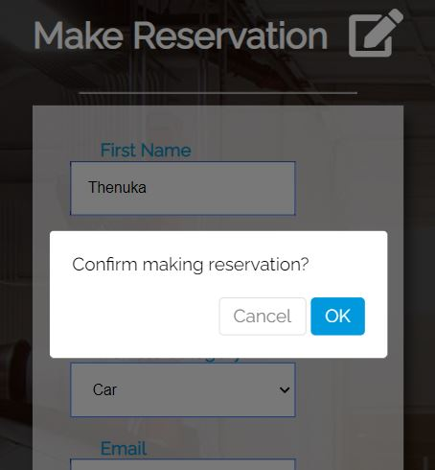
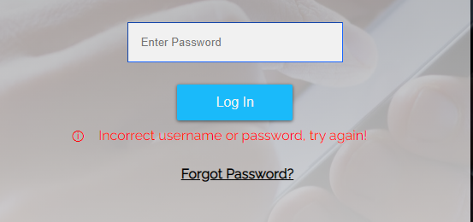
Usability & User experience
Using confirmation boxes for necessary choices
Show warnings for incorrect choices and errors

Slide 18
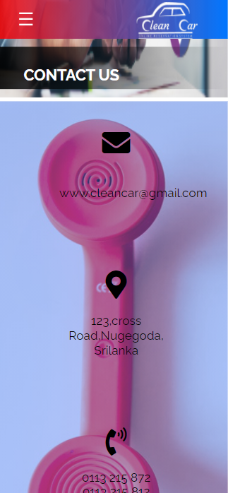
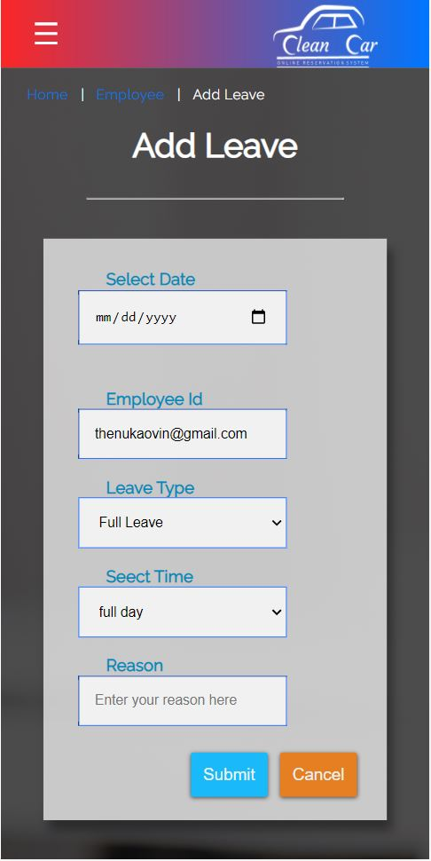
Usability & User experience
Responsive web design

Slide 19
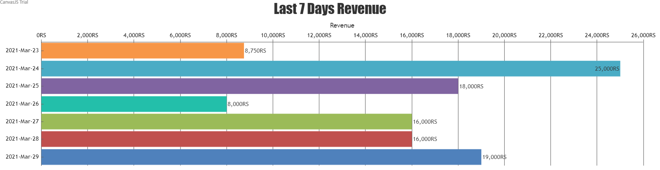
Usability & User experience
Data visualization and summarizing

Slide 20

Testing:
Unit Testing
Integration Testing
System Testing
Eg:
Testing of “Employee requesting Leave
Check if the added leave goes into the database.
Check if the leave is placed under the Manager’s “Pending Leaves” section.
Check the entire functionality of the Pending Leaves section.
Test cases were separately documented according to the user functionalities.

Slide 21
Overall System Completeness:
According to the initial SRS:
For All: | Registration,Login.Logout | Complete
Customer | Online Reservation | Complete
 | Smart Calendar | Complete
 | Cancel Reservation | Complete
 | Advance Payment | Halfway implemented (hosting issues)
Employee | Add /Cancel Leave | Complete
 | Check leaves taken/available | Complete
 | View account details | Complete
Receptionist | Delaying the timetable | Complete
 | Add/Delete employees | Complete
 | Invoice generation and billing | Complete
 | View Reservation details | Complete
Manager | Add, Delete Service Types, Time Slots | Complete
 | View Reports/ Visualize Data | Complete

Slide 22
Overall System Completeness:
According to the initial SRS:
Components | E-mail | Complete
 | PDF bill generator | Complete
 | SMS notifier | Complete
 | JavaScript data visualization | Complete

Slide 23
Technologies

Slide 24





Programming/Scripting Languages used:
Programming Languages | Php, SQL, JavaScript , JQuery
Markup ,style script languages | HTML, CSS
Database | MYSQL
Other tools used:
UI/UX Implementation,Logos | Balsamiq, Adobe Photoshop
Collaboration platform | Github
Tools | Draw.io
Communication and planning | Trello, Discord

Slide 25


Only external libraries used:
PHPmailer | To send email notifications
Fpdf library | To generate PDFs
Nexmo | To send SMS notifications
ChartJS | To visualize and generate charts from data
Main focus:
To implement the entire system with the least number of external libraries as possible.

Slide 26

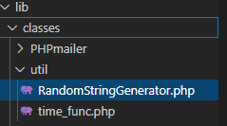
Technical knowledge
Programming language and debugging knowledge in :
HTML/CSS : Responsive web design ,Animations
PHP : Database fetching, Array functions ,Data structures
JavaScript: onClick functions, listeners, DOM element fetching
MySQL: Complex query construction for required functions (e.g.: Queries to get backend data for customer timetable)
Separate tailor-made functions for validation (Modularity):
Regex functions: Vehicle number, NIC validations
Other Utility functions: Time related string formatting, Random String generating etc.

Slide 27
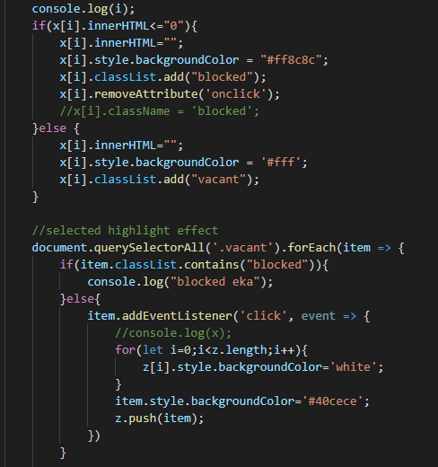
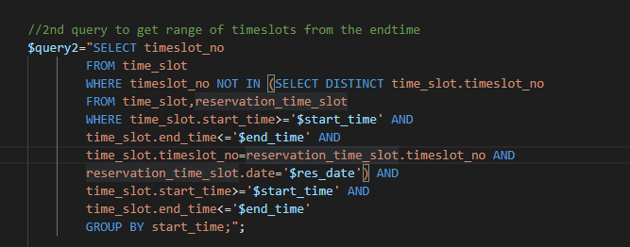
Technical knowledge
SQL Queries constructed
JavaScript functions:

Slide 28




Theoretical knowledge
Gained an understanding in Software Development life Cycle
How to work collaboratively in developing S/W as a team.
Debugging and using version-controlling S/W
Constraints in using SQL databases.

Slide 29
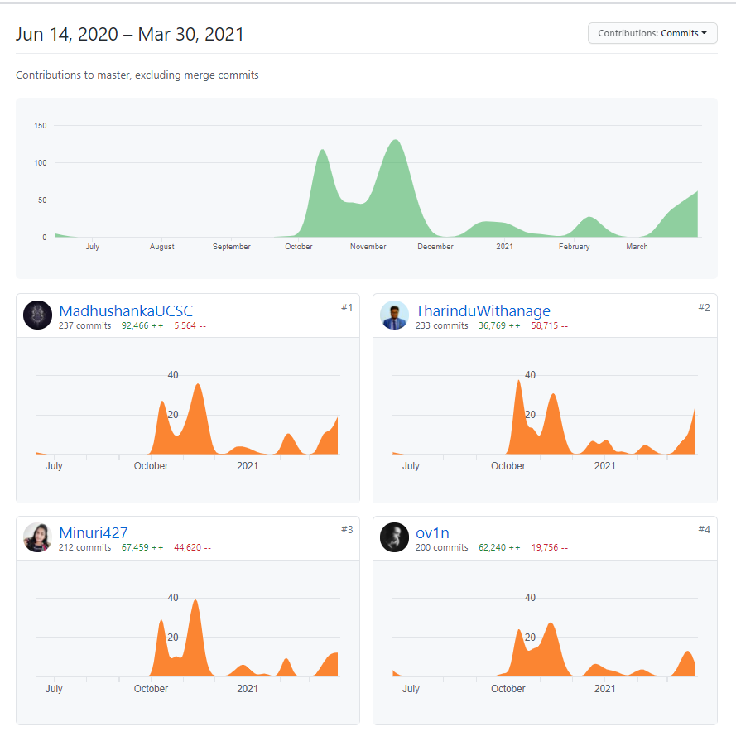
Work Plan
Version Controlling and
contributions
https://github.com/ov1n/Cleancar

Slide 30
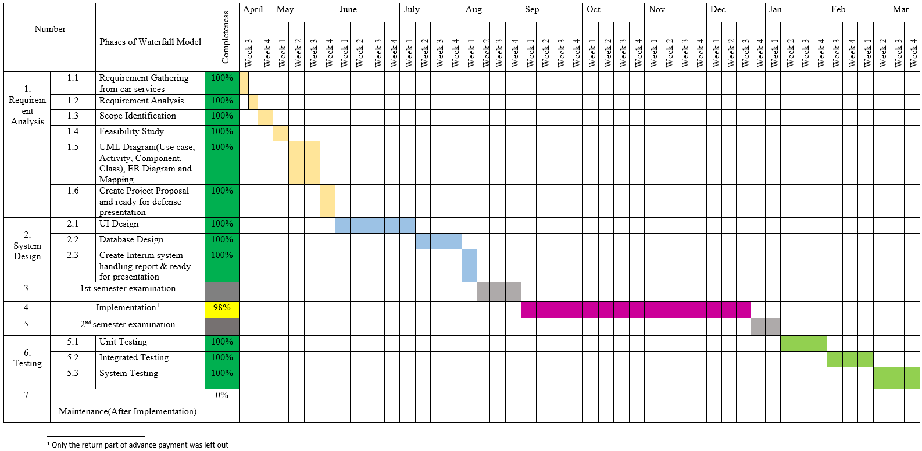
Work Plan
Gantt chart

Slide 31

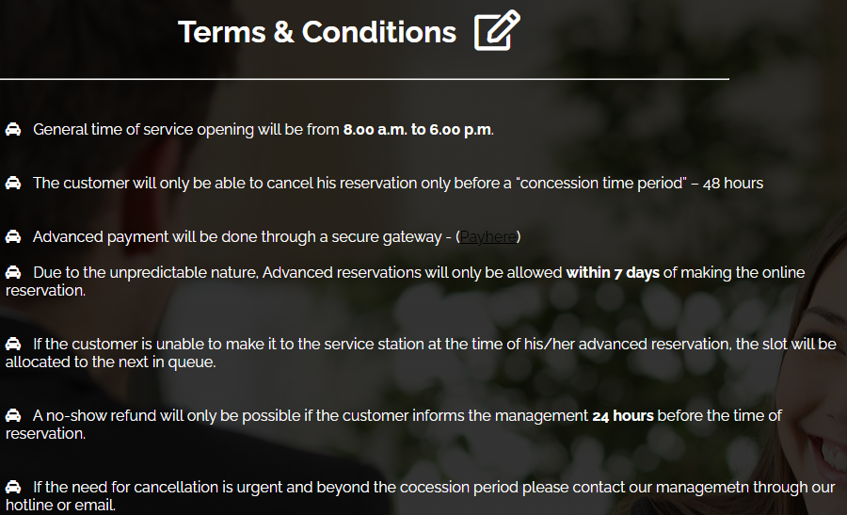
Special attributes of project:
System was made according to the feedback obtained from real-world Car service managers

Slide 32



Planned Future Enhancements:
Host the system in public domain and fully implement Payhere gateway integration to get payment confirmations.
Salary calculation method for employees based on lieu taking.
Stock management with relevant billing for them.

Slide 33

Demonstration

Slide 34
Q & A

